Slide 1
Pipelining and Vector Processing
Unit III

Slide 2
Topics
Parallel Processing
Pipelining
Arithmetic Pipeline
Instruction Pipeline
RISC Pipeline
Vector Processing
Array Processors

Slide 3
PARALLEL PROCESSING
Execution of Simultaneous Data Processing activities to achieve faster Computational Speed
    Eg. ALU executing instruction while another instruction is being fetched.
Aim – increase throughput (amount of work done in unit time)‏
Amount of hardware increases with parallel processing.

Slide 4
PARALLEL COMPUTERS
Architectural Classification
  Flynn's classification
    Based on the multiplicity of Instruction Streams and Data Streams
    No. of instructions and data items that are manipulated simultaneously.
    Instruction Stream
      Sequence of Instructions read from memory
    Data Stream
      Operations performed on the data in the processor
Number of Data Streams
Single
Multiple
Number of
Instruction
Streams
Single
SISD
SIMD
Multiple
MISD
MIMD

Slide 5
SISD COMPUTER SYSTEMS
Single processor executes a single instruction stream to operate on data stored in a single memory.
Parallel processing achieved by multiple functional units (adder, logic unit etc) or pipeline processing.
Instructions executed sequentially.
Uniprocessors.
Control
Unit
Instruction stream
Processor
Unit
Data stream
Memory

Slide 6
SIMD Computers
Many processing units , one control unit.
All processors receive same instruction but work on different data.
Shared memory unit contains multiple modules.
Vectors and array processors
Control Unit
Instruction stream
P
P
• • •
P
Processor units
Data stream
M
M
• • •
M
Memory modules

Slide 7
MISD Computer
A sequence of data is transmitted to a set of processors, each of which execute a different instruction sequence.
There is no computer at present that can be classified as MISD
CU
P
CU
P
Memory
•
•
•
CU
P
Data stream
Instruction stream

Slide 8
MIMD Computer
Processing several programs at the same time.
Multiple processing units
Execution of multiple instructions on multiple data
Types of MIMD computer systems
  Shared memory multiprocessors
  Message-passing multicomputers
P
M
P
M
• • •
P
M
Interconnection Network
Shared Memory

Slide 9
Pipelining
  A technique of decomposing a sequential process into suboperations, with each subprocess being executed in a special dedicated segment that operates concurrently with all other segments.
  Each segment performs partial processing depending on the way the subprocesses are created.
  Result from each segment processing transferred to the next segment in the pipeline.

Slide 10
Pipelining
A_{i} * B_{i} + C_{i} for i = 1, 2, 3, ... , 7
A_{i}
B_{i}
Memory
C_{i}
Segment 1
R1
R2
Multiplier
Segment 2
R3
R4
Segment 3
Adder
R5
R1 ← A_{i}, R2 ← B_{i} Load A_{i} and B_{i}
R3 ← R1 * R2, R4 ← C_{i} Multiply and load C_{i}
R5 ← R3 + R4 Add

Slide 11
OPERATIONS IN EACH PIPELINE STAGE
Clock Pulse No.
Segment 1
Segment 2
Segment 3
R1
R2
R3
R4
R5
1
A1
B1
2
A2
B2
A1 * B1
C1
3
A3
B3
A2 * B2
C2
A1 * B1 + C1
4
A4
B4
A3 * B3
C3
A2 * B2 + C2
5
A5
B5
A4 * B4
C4
A3 * B3 + C3
6
A6
B6
A5 * B5
C5
A4 * B4 + C4
7
A7
B7
A6 * B6
C6
A5 * B5 + C5
8
A7 * B7
C7
A6 * B6 + C6
9
A7 * B7 + C7

Slide 12
General Pipeline
General Structure of a 4-Segment Pipeline
Clock
Input
S
R
S
R
S
R
S
R
1
1
2
2
3
3
4
4
Space-Time Diagram
1
2
3
4
5
6
7
8
9
Clock cycles
Segment
1
T1
T2
T3
T4
T5
T6
2
T1
T2
T3
T4
T5
T6
3
T1
T2
T3
T4
T5
T6
4
T1
T2
T3
T4
T5
T6
Ti ; Tasks (total operation performed going through all segments in a pipeline

Slide 13
Pipeline Speedup
  n: Number of tasks to be performed
Conventional Machine (Non-Pipelined)‏
  t_{n}: Clock cycle
  τ₁: Time required to complete the n tasks
  τ₁ = n * t_{n}
Pipelined Machine (k stages)‏
  t_{p}: Clock cycle (time to complete each suboperation)‏
  τ_{κ}: Time required to complete the n tasks
  τ_{κ} = (k + n - 1) * t_{p}
Speedup
  S_{k}: Speedup
S_{k} = n*t_{n} / (k + n - 1)*t_{p}
As no. of tasks increases, n becomes much larger than k-1 and k+n-1 approaches n. therefore S_{k} = t_{n} / t_{p}
If t_{n} =k* t_{p} ( time taken to process a task is same for pipelined and non-pipelined circuits), then
S_{k} = k t_{p} / t_{p} = k (theoretical max speedup)‏

Slide 14
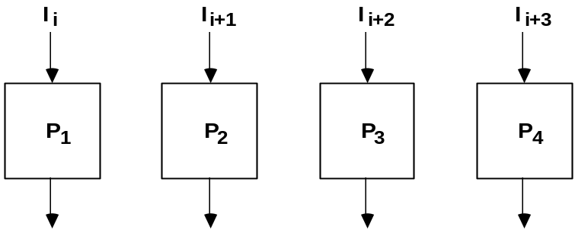
Example
Example
- 4-stage pipeline
- subopertion in each stage; tp = 20nS
- 100 tasks to be executed
- 1 task in non-pipelined system; 20*4 = 80nS
Pipelined System
(k + n - 1)*tp = (4 + 99) * 20 = 2060nS
Non-Pipelined System
n*k*tp = 100 * 80 = 8000nS
Speedup
Sk = 8000 / 2060 = 3.88
4-Stage Pipeline is basically identical to the system
with 4 identical function units
Multiple Functional Units

Slide 15
Max Speedup for Pipeline
Maximum speedup i.e k (no of segments) is theoretical.
Different segments may take different time to complete execution of suboperations.
Clock cycle equal to max delay.
Many intermediate registers may not be required for non pipelined units.

Slide 16
Types of Pipelining
Two types of pipelining
  Arithmetic pipelining
    Arithmetic operations divided into suboperations for execution in pipeline segments.
  Instruction Pipelining
    Overlaps the fetch, decode and execute phases of several instructions.

Slide 17
Arithmetic Pipelining
Exponents
Mantissas
a
b
A
B
R
R
Segment 1:
Compare
Difference
Floating-point adder
exponents
by subtraction
X = A x 2ª
Y = B x 2^{b}
R
Segment 2:
Choose exponent
Align mantissa
[1] Compare the exponents
[2] Align the mantissa
[3] Add/sub the mantissa
[4] Normalize the result
R
Segment 3:
Add or subtract
mantissas
R
R
Segment 4:
Adjust
Normalize
exponent
result
R
R

Slide 18
Example
X = 0.9504 x 10^{3 ,} Y =0.8200 x 10²
Segment 1
  Subtract exponents obtain 3-2=1.
  The larger exponent is chosen as the exponent of the result.
Segment 2
  Shift mantissa of Y to get X = 0.9504 x 10^{3 ,} Y =0.0820 x 10³
Segment 3
  Add the two mantissa to get the sum Z=1.0324 x 10³
Segment 4
  Normalize result, Z=0.10324 x 10⁴
If time delays of the 4 segments are t1=60ns, t2=70ns, t3=100ns, t4=80ns and register delay tr=10ns,
  Tp=t3+tr=110 ns
  Non-pipelined , Tn=t1+t2+t3+t4+tr=320ns

Slide 19
Instruction Pipelining
Instruction pipeline read instructions from memory while previous instructions are executing in some other segment.
Phases of instruction cycle
  Fetch an instruction from memory
  Decode the instruction
  Calculate the effective address of the operand
  Fetch the operands from memory
  Execute the operation
  Store the result in the proper place
Not all phases are required for all operations.

Slide 20
Four- Segment Instruction Pipeline
FI: Fetch an instruction from memory
DA: Decode the instruction and calculate the effective address of the operand
FO: Fetch the operand
EX: Execute the operation

Slide 21
Execution of three instructions in a 4 stage pipeline
Conventional
Pipelined
i
FI
DA
FO
EX
i
FI
DA
FO
EX
i+1
FI
DA
FO
EX
i+2
FI
DA
FO
EX
i+1
FI
DA
FO
EX
i+2
FI
DA
FO
EX

Slide 22
Four-Segment CPU Pipeline
Segment1:
Fetch instruction
from memory
Decode instruction
Segment2:
and calculate
effective address
yes
Branch?
no
Segment3:
Fetch operand
from memory
Segment4:
Execute instruction
Interrupt
yes
Interrupt?
handling
no
Update PC
Empty pipe

Slide 23
Timing of Instruction pipeline
Step:
1
2
3
4
5
6
7
8
9
10
11
12
13
Instruction
1
FI
DA
FO
EX
2
FI
DA
FO
EX
(Branch)‏
3
FI
DA
FO
EX
4
FI
FI
DA
FO
EX
5
FI
DA
FO
EX
6
FI
DA
FO
EX
7
FI
DA
FO
EX

Slide 24
Pipeline Conflicts
Resource conflicts
  Two segments wants to access memory at the same time.
  Can be solved by two buses for data and instructions.
Data dependency
  Instruction depends on the result of another instruction.
Branch difficulties
  Value of Program Counter changes after a branch

Slide 25
Resource Conflicts
Example: With one memory-port, a data and an instruction fetch
cannot be initiated in the same clock
i
FI
DA
FO
EX
i+1
FI
DA
FO
EX
i+2
stall
stall
FI
DA
FO
EX
The Pipeline is stalled for a resource conflict.

Slide 26
Data Dependency
ADD
DA
B,C
+
Data dependency
  R1 <- B + C
  R1 <- R1 + 1
INC
DA
bubble
R1
+1

Slide 27
Branch Difficulties
JMP
ID
PC
+
PC
Branch address dependency
bubble
IF
ID
OF
OE
OS

Slide 28
Handling Data Dependencies
Hardware Interlocks
  Circuit that detects conflict and delays the instruction whose source is not available.
Operand Forwarding
  Circuit detects conflict and routes data through special paths between pipeline segments.
  Result of ALU operation is input to the ALU bypassing the destination.
Delayed Load
  Compiler detects conflicts and reorders instructions to delay conflicting data by inserting no operations.

Slide 29
Forwarding Hardware
Example:
ADD R1, R2, R3
SUB R4, R1, R5
3-stage Pipeline
I: Instruction Fetch
A: Decode, Read Registers,
ALU Operations
E: Write the result to the destination register
Register
file
Result
write bus
MUX
MUX
path
ALU
ADD
I
A
E
SUB
Without Bypassing
R4
I
A
E
ALU result buffer
SUB
I
A
E
With Bypassing

Slide 30
Delayed Load
a = b + c;
d = e - f;
Unscheduled code:
Scheduled Code:
LW Rb, b
LW Rc, c
ADD Ra, Rb, Rc
SW a, Ra
LW Re, e
LW Rf, f
SUB Rd, Re, Rf
SW d, Rd
LW Rb, b
LW Rc, c
LW Re, e
ADD Ra, Rb, Rc
LW Rf, f
SW a, Ra
SUB Rd, Re, Rf
SW d, Rd

Slide 31
Handling of Branch Instructions (1)‏
Perfetch Target Instruction
  Prefetch target along with instruction following branch.
  If branch condition successful, pipeline continues with branch target instruction.

Slide 32
Handling of Branch Instructions (2)‏
Branch Target Buffer
  BTB is an associative memory present in the fetch segment of the pipeline.
  Each entry contains address of previously executed branch and target of that branch.
  On decoding a branch instruction, the BTB is searched.
  If found, instruction is available directly.
  If not found, pipeline shifts to new instruction stream and makes entry in BTB.

Slide 33
Handling of Branch Instructions (3)‏
Loop buffer
  Small, high speed file in the instruction fetch segment.
  For program loops, all instructions stored in the loop buffer.
  Program can execute entire loop without having to access memory.

Slide 34
Handling of Branch Instructions (4)‏
Branch prediction
  Additional logic to predict branch before it is executed.
  Prefetch instruction stream from predicted path.
Delayed branch
  Compiler detects branch and rearranges instructions by placing useful instructions that keep the pipeline operating.

Slide 35
RISC Pipeline
Characteristics
  Simple instruction set.
  Fixed length instruction format.
  All data manipulation instructions are register to register.
  No need for calculation of effective address and fetch data from memory.
  Data transfer only load and store.
  Two separate buses and memories for data and instruction.
  Execute instructions at the rate of one per clock cycle.

Slide 36
DELAYED LOAD
  LOAD: R1 ← M[address 1]
  LOAD: R2 ← M[address 2]
  ADD: R3 ← R1 + R2
  STORE: M[address 3] ← R3
  LOAD: R1 ← M[address 1]
  LOAD: R2 ← M[address 2]
  ADD: R3 ← R1 + R2
  STORE: M[address 3] ← R3
Three-segment pipeline timing
  I : Instruction fetch
  A: ALU operation
  E : Execute operation
Pipeline timing with data conflict
clock cycle 1 2 3 4 5 6
Load R1 I A E
Load R2 I A E
Add R1+R2 I A E
Store R3 I A E
Pipeline timing with delayed load
clock cycle 1 2 3 4 5 6 7
Load R1 I A E
Load R2 I A E
NOP I A E
Add R1+R2 I A E
Store R3 I A E
The data dependency is taken
care by the compiler rather
than the hardware

Slide 37
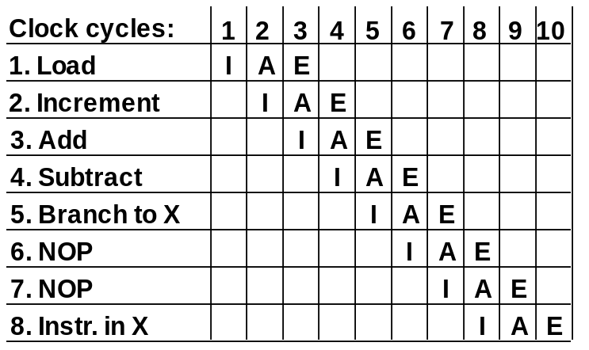
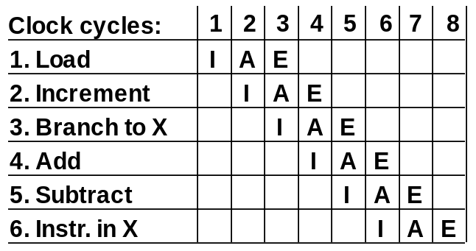
DELAYED BRANCH
Compiler analyzes the instructions before and after
the branch and rearranges the program sequence by
inserting useful instructions in the delay steps
Using no-operation instructions
Rearranging the instructions

Slide 38
Vector Processing
Class of problems which can take a lot of time (days or weeks) for processing by a conventional computer.
Problems can be formulated in terms of vectors and matrices.
Application areas
  Long-range weather forecasting
  Petroleum exploration
  Seismic data analysis
  Medical diagnosis
  Artificial intelligence and expert systems
  Image processing etc.

Slide 39
VECTOR PROGRAMMING
DO 20 I = 1, 100
20 C(I) = B(I) + A(I)‏
Conventional computer
Initialize I = 0
20 Read A(I)‏
Read B(I)‏
Store C(I) = A(I) + B(I)‏
Increment I = i + 1
If I ≤ 100 goto 20
Vector computer
C(1:100) = A(1:100) + B(1:100)‏

Slide 40
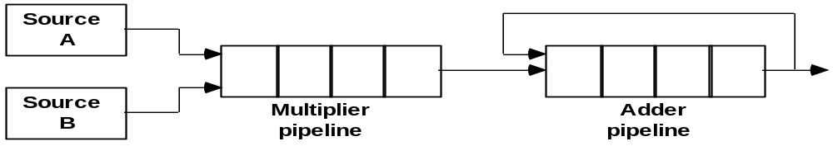
VECTOR INSTRUCTION FORMAT
Vector Instruction Format
Pipeline for Inner Product

Slide 41
MULTIPLE MEMORY MODULE AND INTERLEAVING
Multiple Module Memory
Address bus
M0 M1 M2 M3
AR
AR
AR
AR
Memory
Memory
Memory
Memory
array
array
array
array
DR
DR
DR
DR
Data bus
Address Interleaving
Different sets of addresses are assigned to
different memory modules

Slide 42
Supercomputer
A computer capable of performing vector instructions and pipelined floating-point arithmetic operations.
Used for scientific computations.
Components packed together closely to reduce travel distance for signals.
Special techniques for removing heat.
High computational speed, fast and large memory.
Additional instructions for manipulation vectors and combination of scalars and vectors.
Supercomputer can perform 50-250 megaflops.
  no. of floating point operations per second – flops.
  Mega – million flops
  Giga – billion flops
Clock cycle time – 4 to 20 ns.

Slide 43
Array Processors
Processor that performs computations on large arrays of data.
Two types
  Attached Array Processor
    Auxillary processor attached to a general purpose computer to improve performance.
  SIMD Array Processor
    Single instruction multiple data processor.
    Manipulates vector instructions by means of multiple functional units responding to a common instruction.

Slide 44
Attached Array Processor
General Purpose
computer
Input-Output
Interface
Attached Array
Processor
Main Memory
Local memory
High Speed Memory-To-Memory Bus

Slide 45
SIMD Array Processor Organization
PE1
M1
Master Control
Unit
PE2
M2
PE3
M3
Main Memory
PEn
Mn

Slide 46
SIMD Array Processor
Multiple processing units operating in parallel.
Synchronized by a common control unit.
Set of identical processing units, each with local memory.
Each PE includes
  ALU
  Floating-point arithmetic unit.
  Working registers.
Main memory used for storage of program.
Master control unit decodes instructions and executes scalar and control instructions.
Vector instructions are broadcast to all PE simultaneously.
Vector operands are distributed to local memories.
PE uses operands in its local memories.

Slide 47
SIMD Array Processor
Vector addition C=A+B.
  Master control unit stored ai and bi in local memory Mi. i=1,2....n
  Broadcasts instruction ci=ai+bi to all PE.
  ci stored in local memory Mi.
Each PE has a flag that is set when it is active.
Eg. if n=32 and no. of PE=50, status flag needs to be set for only 32 PE.
If n>no. of PE, master control unit breaks down vector into words of size equal to no of PE

